Slide 1
INSTRUCTIONS
This is a DART activity (Directed Activity Related to Text) designed to support literacy. It focuses on the strategies of:
Skimming
Scanning
Gap Fill
Set up the presentation to suit the reading ability of your class (see screenshot) . A setting of 0.4 seconds between each word appearing typewriter fashion would suit a mid to high ability class
Print the key words slide and cut out the words. You could tape them to the underneath of chairs for random distribution if you wanted.
Run the presentation so that students skim and scan the text. This is a way of engaging students with the kind of text they would find in a textbook, but without the textbook!
Selected students take turns come to the front to draw their key word whilst others try to guess it.
Follow-up with the gap fill exercise.

Slide 2
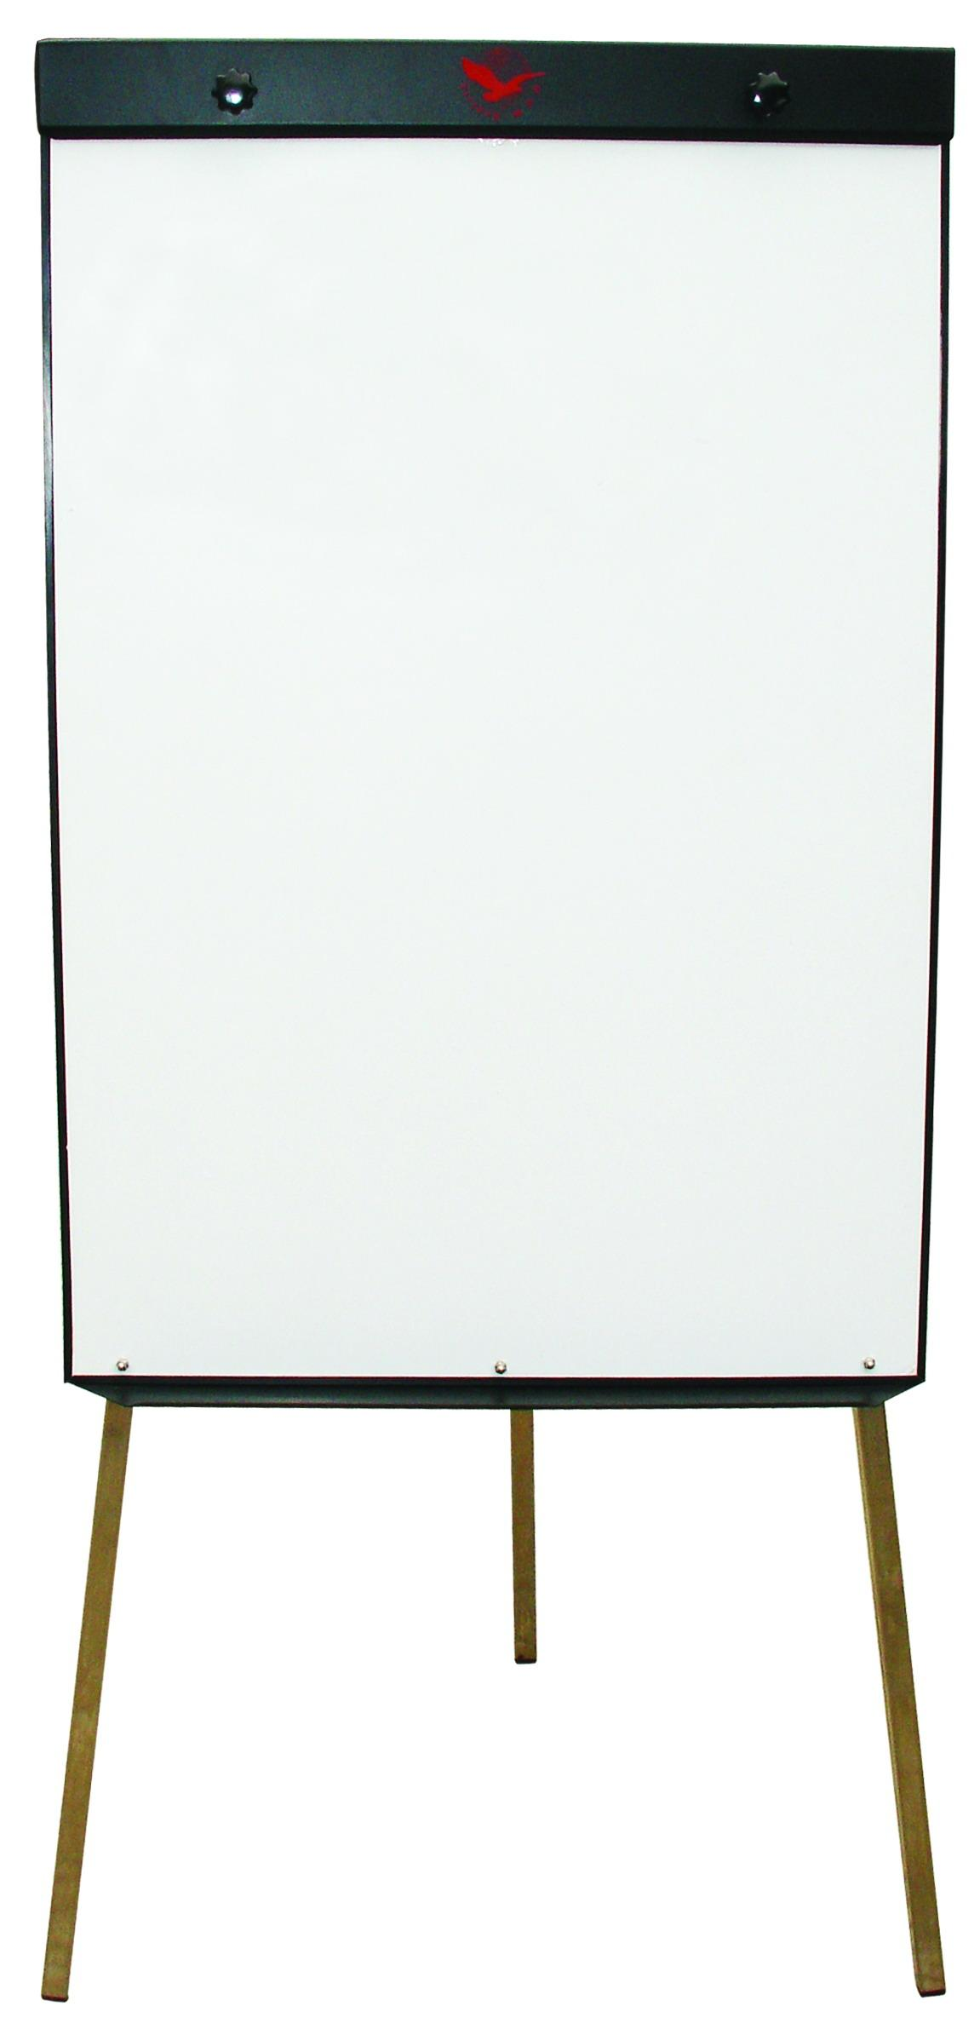

Slide 3
Central Processing Unit (CPU) Intro At the heart of every computer is the Central Processing Unit or CPU. This executes the program instructions and controls the other elements of the computer. In order to do this the computer needs access to:
random access memory or RAM, where instructions and data are stored
cache memory which is used to store data waiting to be processed

Slide 4
As soon as the computer starts up, the CPU runs an endless fetch-decode-execute cycle, constantly fetching instructions and decoding them. The speed of the CPU is set by a chip which determines the CPU’s clock speed, which is measured in Hertz. Data is moved around the system along a bus. A bus simply connects one part of the motherboard to another.

Slide 5
Some CPUs utilise multiple cores. This is simply two or more CPUs working together. Essentially this means that different processes can be run on different cores. This speeds up Multitasking. Data is stored in the form of a 0 or 1, otherwise known as a bit. 4 bits are called a nibble, 8 bits are called a byte. 1024 bytes are called a kilobyte.

Slide 6
Central Processing Unit (CPU) Intro At the heart of every computer is the Central Processing Unit or CPU. This executes the program instructions and controls the other elements of the computer. In order to do this the computer needs access to:
random access memory or RAM, where instructions and data are stored
cache memory which is used to store data waiting to be processed
As soon as the computer starts up, the CPU runs an endless fetch-decode-execute cycle, constantly fetching instructions and decoding them. The speed of the CPU is set by a chip which determines the CPU’s clock speed, which is measured in Hertz. Data is moved around the system along a bus. A bus simply connects one part of the motherboard to another.
Some CPUs utilise multiple cores. This is simply two or more CPUs working together. Essentially this means that different processes can be run on different cores. This speeds up Multitasking. Data is stored in the form of a 0 or 1, otherwise known as a bit. 4 bits are called a nibble, 8 bits are called a byte. 1024 bytes are called a kilobyte.

Slide 7
Pick a key word and draw it

Slide 8
EXECUTE
BYTE
HERTZ
CACHE MEMORY
RAM
MOTHERBOARD
BUS
FETCH
KILOBYTE
CLOCK SPEED
DUAL CORE
CYCLE

Slide 9
Central Processing Unit (CPU)
At the heart of every computer is the Central Unit or CPU. This executes the program instructions and controls the other elements of the computer. In order to do this the computer needs access to:
random access memory or , where instructions and data are stored
memory which is used to store data waiting to be processed
As soon as the computer starts up, the CPU runs an endless fetch-decode-execute cycle, constantly fetching instructions and decoding them. The speed of the CPU is set by a chip which determines the CPU’s clock speed, which is measured in Data is moved around the system along a . A bus simply connects one part of the to another.
Some CPUs utilise multiple cores. This is simply two or more CPUs working together. Essentially this means that different processes can be run on different cores. This speeds up Multitasking. Data is stored in the form of a 0 or 1, otherwise known as a bit. 4 bits are called a , 8 bits are called a byte. 1024 bytes are called a .
RAM kilobyte Processing cache
nibble bus Hertz motherboard

