Slide 1
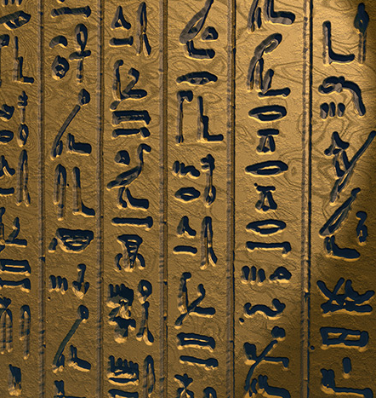
The Pharaoh’s Tomb
You are an archaeologist and you have just uncovered an ancient scroll in an Egyptian Pharaoh’s tomb. As you lift the scroll carefully from the dirt floor, the chamber door begins to creak and dirt begins to fall. The door slowly begins to lower. A shadow blocks the light from a hole in the tomb ceiling, revealing the number 45 on the wall. You realise the stories are true! You only have 45 minutes to find the clues around the room to unlock the boxes that will give you the key to escape the chamber. If not the keyhole in the chamber door will disappear into the earth and you will be stuck in the chamber forever. Can you escape?

Slide 2
C F G A N P T S R Q C J L H Z

Slide 3
C F G A N P T S R Q C J L H Z

Slide 4
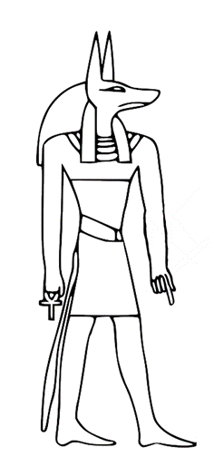
14 + 3
10 + 8
11 + 9
13 + 3
12 + 7

Slide 5
17
18
20
16
19

Slide 6
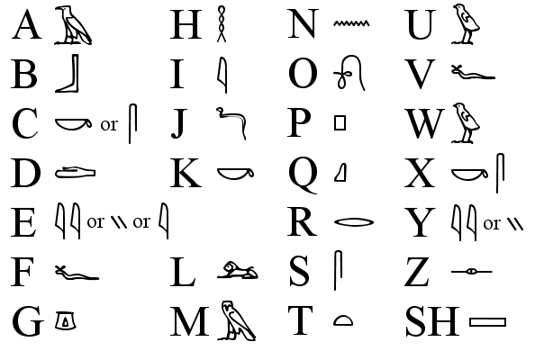
Egyptian Hieroglyphic Alphabet
A
H
N
U
B
I
O
V
C
J
P
W
D
K
Q
X
E
R
Y
F
L
S
Z
G
M
T

Slide 7
Egyptian Hieroglyphic Alphabet
1
2
3
4
5
6
7
8
9
10
11
12
13
14
15
16
17
18
19
20
21
22
23
24
25
26

Slide 8
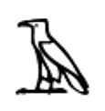
SELECT THE NUMBERS THAT WILL OPEN THE LOCK
0
1
2
3
4
5
6
7
8
9

Slide 9
18
9
1
3
2
8
10
10
5
3
2
SELECT THE NUMBERS THAT WILL OPEN THE LOCK
0
1
2
3
4
5
6
7
8
9
2
4
0
2
5

Slide 10
SELECT THE NUMBERS THAT WILL OPEN THE LOCK
0
1
2
3
4
5
6
7
8
9
5
6
7

Slide 11
1 + 4
1
10 / 2
9 - 4

Slide 12
12 / 2
3 x 2
10 - 4

Slide 13
1 + 6
(2 x 2) + 3
10 - 3

